Slide 1
UNIT FIVE : ENERGY
Sources of Energy
Fossil Fuels

Slide 2
How Does Energy Relate to Agriculture?
Agricultural products surround us.
Farms use a tremendous amount of energy in various forms to raise crops … electricity to heat chickens, fuel for tractors, natural gas for fertilizer, and so on.
Everyone who eats, wears clothes, lives in a home, and reads the newspaper is dependent upon agriculture.
Agriculture directly generates over 22 million jobs in the US, a multi-billion dollar industry.

Slide 3

Energy is a Necessary Component of Any Society
Since the dawn of man, energy has
played a vital role in survival.
All of the Earth’s various natural ecosystems are arranged in layers of efficient energy consumption.
Countries rely on energy for production of goods and population growth, and always will.
Management of available energy is dependent upon man’s foresight or negligence …

Slide 4
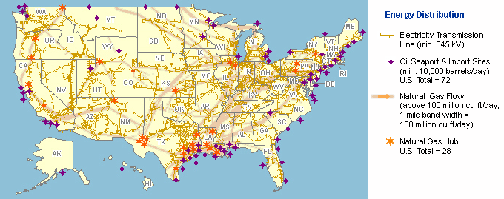
Energy Distribution in the US
(source: Energy Information Administration, 2008)

Slide 5
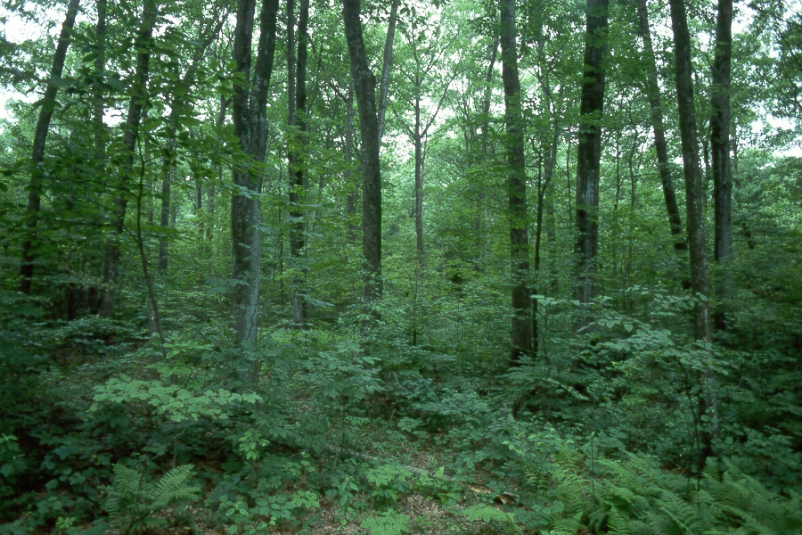
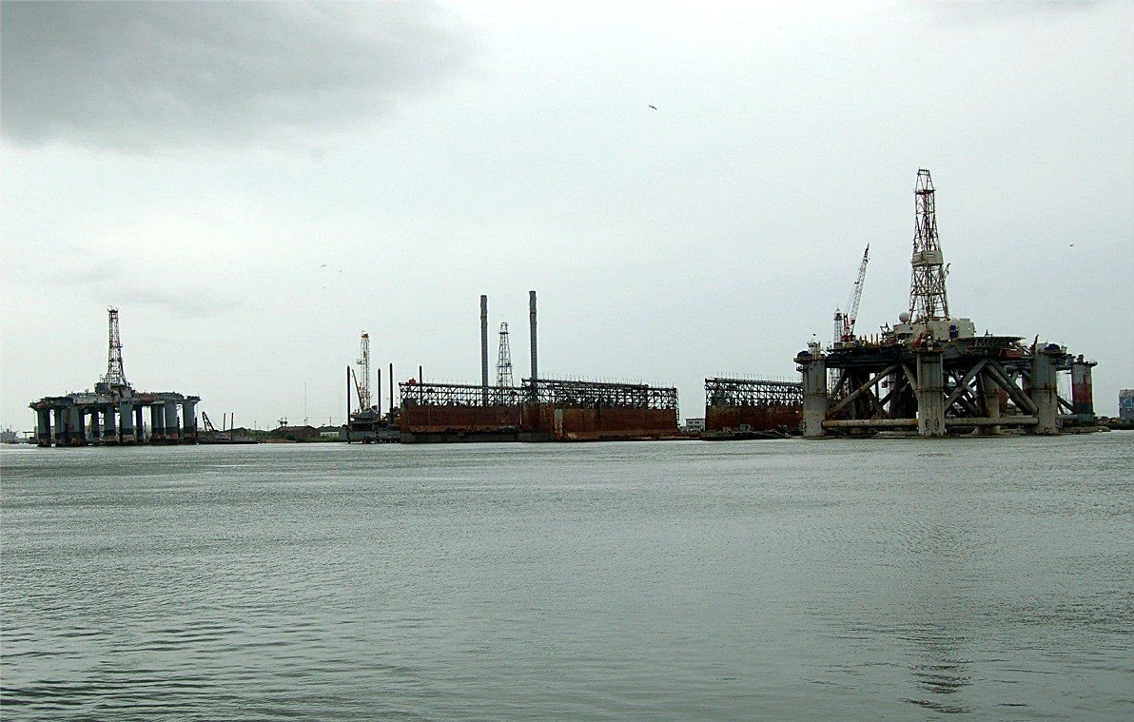
There are Two Basic Forms of Energy:
and
For more detailed information on these two types of energy, click HERE
RENEWABLE
NONRENEWABLE

Slide 6
“Energy” is the Ability to do Work
Renewable forms:
  Solar
  Wind
  Geothermal
  Water
    Hydroelectric
    Tidal
  Biomass
Non-Renewable forms:
  Coal
  Oil
  Natural Gas
  Nuclear
Carriers of Energy:
Electricity
Hydrogen

Slide 7
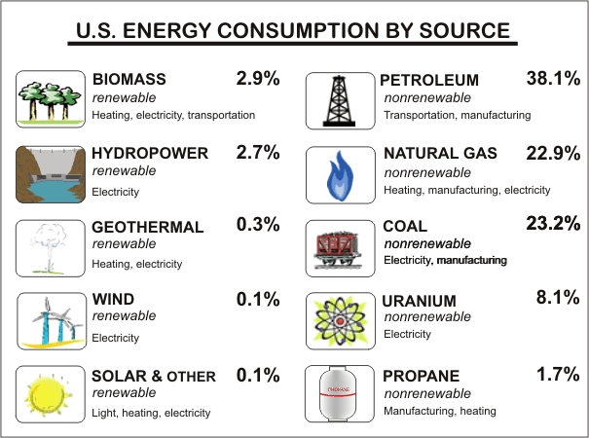
Here’s How We Currently Get Our Energy: (2006 stats, US)
Source: EIA

Slide 8
Fossil Fuels are the most common energy source, but what IS a fossil fuel?
A hydrocarbon deposit, such as petroleum, coal, or natural gas, derived from living matter of a previous geologic time and used for fuel.

Slide 9
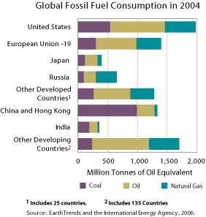
Availability of Fossil Fuels
Over half of the fossil fuels in the world are consumed by the US, China and European Union … countries that are considered “advanced.”

Slide 10

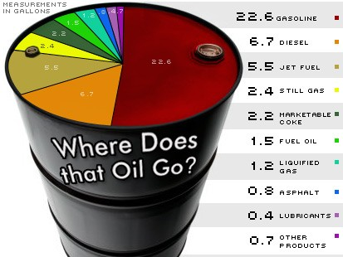
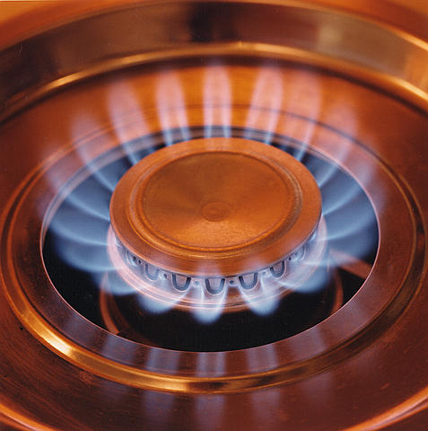
What are the different types of Fossil Fuels? (click on each to find out more)
COAL
OIL
NATURAL GAS

Slide 11
COAL
A combustible black or brownish-black sedimentary rock composed mostly of carbon and hydrocarbons. It is the MOST ABUNDANT fossil fuel in the US.
Photo courtey of CleanTechnica

Slide 12
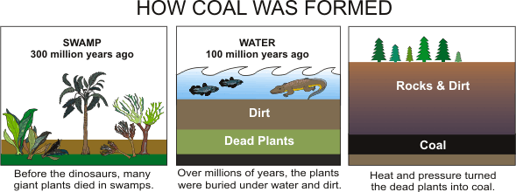
COAL Formation Takes a LONG Time
Source: EIA

Slide 13
Mining Coal: 2 Methods
Surface Mining – Method 1
  Least expensive method.
  Used when coal is less than 200 ft below the surface.
  Topsoil layers are removed and then REPLACED after coal layer has been extracted, allowing for the area to be re-planted or used for other natural sites.
  In the US, it is mandatory that land be returned as closely as possible as was its original state prior to coal removal.

Slide 14
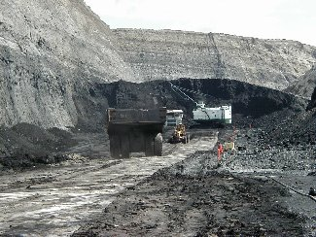
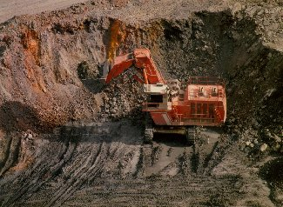
Surface Mining of Coal Removes Land From Agriculture Production
Photos courtesy of SDSM&T

Slide 15
COAL MINING Method 2: Underground Mining
Also called Deep Mining, used when deposits are between 200ft and 1,000ft deep.
Elevators must be used to haul machinery and personnel.
Expensive process, includes much specialized machinery.
Risk of cave-ins and suffocation hazards.

Slide 16
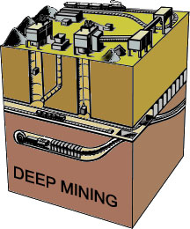
COAL Mining Operations are Hazardous, Especially Deep Mining.
Diagram from EIA

Slide 17
COAL Must Be Processed to Increase the Heating Value and Allow for Cleaner Burning
Common impurities are removed :
  Rocks
  Ash
  Sulfur
  Dirt
  Other unwanted materials

Slide 18
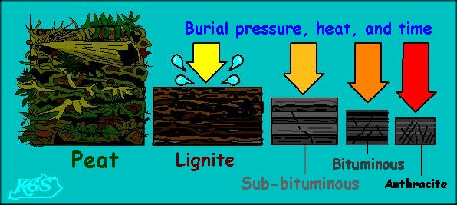
THERE ARE FOUR TYPES OF COAL WE USE FOR FUEL
Source: www.emc.maricopa.edu/faculty/farabee/BIOBK/aK...

Slide 19
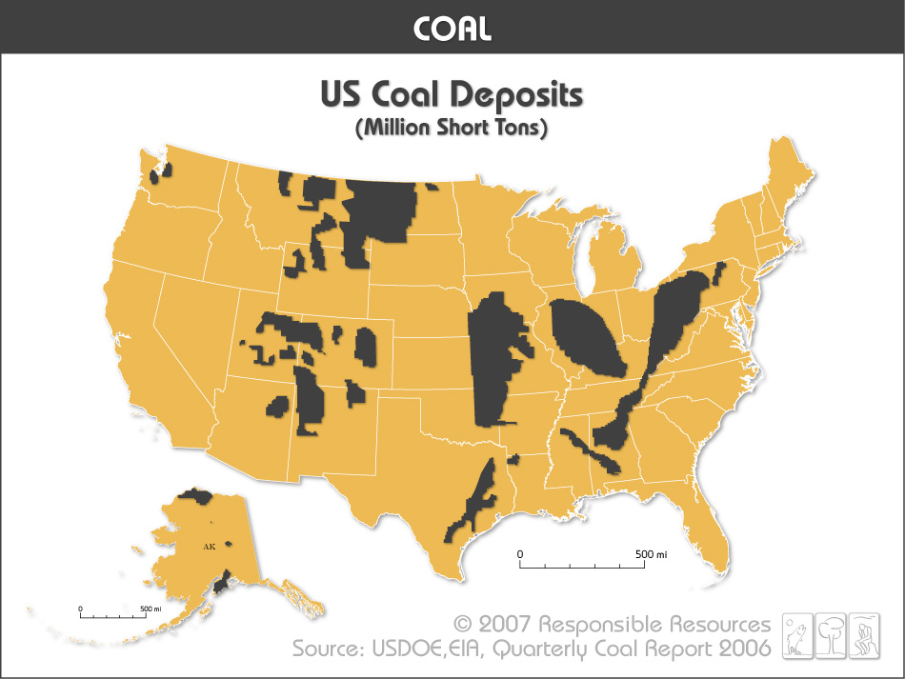
The US has the world’s largest known coal reserves, over 267 billion tons, enough to last over 200 years at the current usage rate.
(http://factsonenergy.com/wp-content/uploads/2007/09/coal_most_abundant_energy_source.pdf

Slide 20
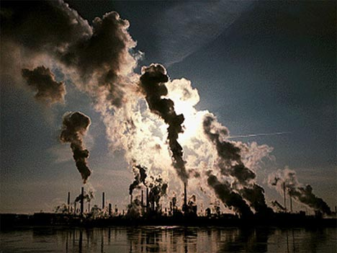
Burning COAL = Pollution
Nearly 50% of the nitrogen oxide (Nox) in the atmosphere and 70% of sulfur dioxide are direct result of emissions released when coal is burned.
These are directly responsible for crop failures from “acid rain” formation (later explained in this presentation).

Slide 21
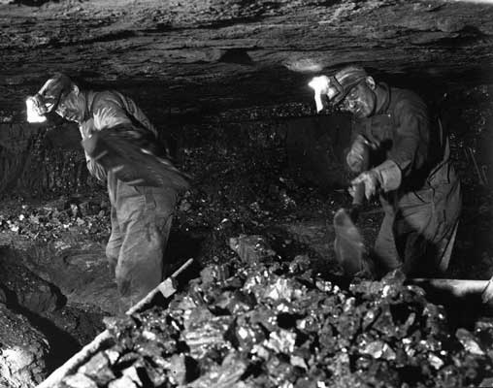
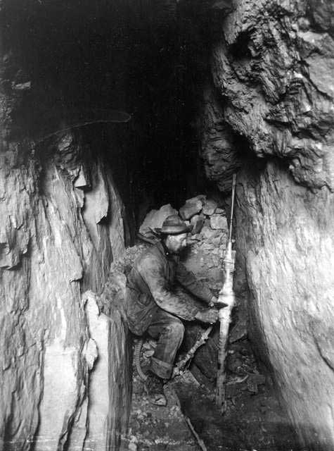
Human Health Issues Surround Coal Mining and its Use
Workers can contract lung diseases, skin diseases and ulcers from coal dust and other impurities mined.
Burning coal produces huge amounts of smog, also related to illness.
Photos courtesy of coalcampmemories.com

Slide 22
Another Important Fossil Fuel is OIL
Oil is derived from Petroleum, the definition of which is : a thick, flammable, yellow-to-black mixture of gaseous, liquid, and solid hydrocarbons that occurs naturally beneath the earth's surface, can be separated into fractions including natural gas, gasoline, naphtha, kerosene, fuel and lubricating oils, paraffin wax, and asphalt and is used as raw material for a wide variety of derivative products.

Slide 23
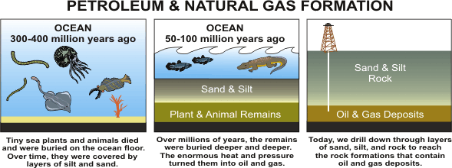
How OIL is Formed
Source: EIA

Slide 24
Where Do We Get Today’s OIL?
Crude oil is a smelly, yellow-to-black liquid and is usually found in underground areas called reservoirs (crude oil = petroleum).
The top 5 OIL-producing nations are Saudi Arabia, USSR, USA, Iran, China.
58% of the crude oil used for fuel and products in the US is imported from other nations.
The top 5 oil-producing states are Texas, Alaska, California, Louisiana, and Oklahoma.

Slide 25
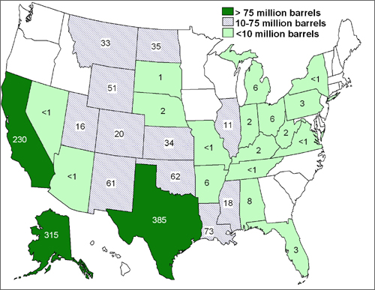
OIL Production in the USA (2005)
http://www1.eere.energy.gov/vehiclesandfuels/facts/2006_fcvt_fotw439.html

Slide 26
Why is OIL in such Demand?
Here’s a partial list of what oil is currently used for:
Cooling, computers, fertilizer, feedstocks, heating, adhesives, paint, plastics, clothing, building materials, medicine, trucks, cars, tractors, fencing, tools, rope, diesel, gasoline, solvents, lubricants, laboratory materials, colognes, detergents, and much, much more … (you are probably wearing oil-related products right now!)

Slide 27
Why Do We Need So Much OIL?
The world population has been steadily increasing, more people means greater energy demand.
Several countries are achieving higher levels of development today, more building and transportation means greater demand for energy.
Oil is an extremely versatile fuel, it can be transformed into many other products.
Oil-derived fuels (such a gasoline) burn easily, burn HOT, and the current transportation industry is designed to use it nearly exclusively.

Slide 28
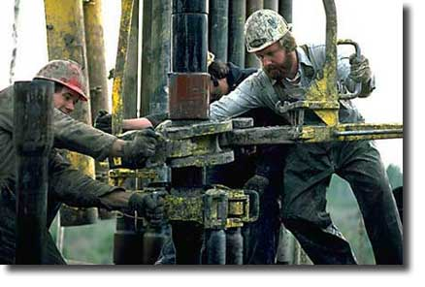
Oil Must be Drilled from Deep Within the Earth
Drilling “Rigs” are constructed both on land and in the ocean to dig into oil reservoirs and search for new oil deposits.
Working these rigs can be very hazardous, safety is a major concern since any petroleum found is under pressure and highly flammable.
Courtesy of BVM Corp.

Slide 29
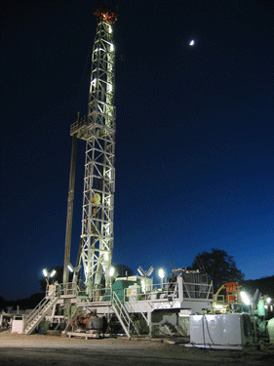
Drilling Rigs
Land-based rigs are smaller and more numerous than offshore.
Smaller crews are needed to operate (usually 5–8 workers).
Fairly easily moved from place to place.
Photo: Compliance Partners, Inc.

Slide 30
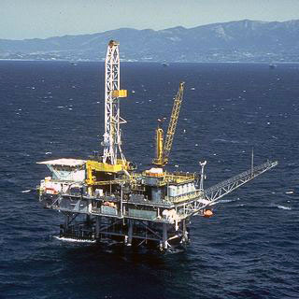
Drilling Rigs
Offshore rigs are much larger and more expensive to build.
Larger crews are needed to operate (usually 25-40 workers).
Extremely hard to move from place to place.
(Credit: Minerals Management Service, US Department of the Interior)

Slide 31
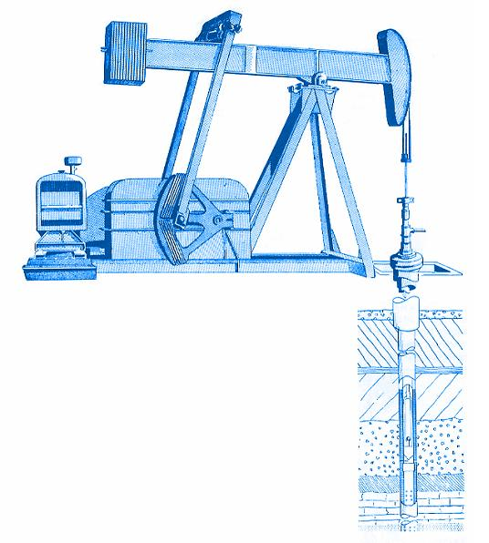
Once the Petroleum Deposit is Found, the “Crude” Must be Pumped and Transported
“Pump jacks” move the crude up from the well into pipelines and storage tanks.
Other stations pump the oil to larger tanks or waiting barges.
Crude is taken to refinery for production into fuel.

Slide 32
Petroleum Must First be REFINED to derive Oil, Gas, and other Fuels!
Refineries are tremendously expensive operations.
Petroleum (crude) is carefully heated to specific temps, and the fumes are collected and cooled back into liquid form (condensates).
Gasoline, diesel, kerosene, etc, all are products of various fume-collection and distillation.
The danger of explosions is constant and extreme.
A typical refinery can process 500,000gal of petroleum per day.

Slide 33
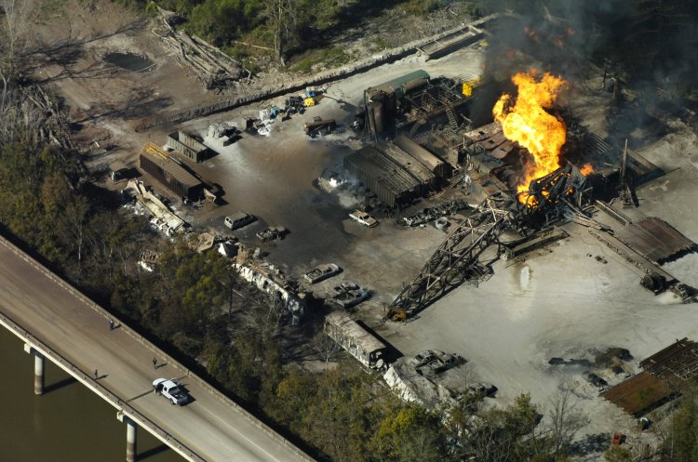
Well Blowout on Atchafalaya Bridge Dec. 2007
http://bp3.blogger.com/_PZ5CL8gE2dk/R0QuPiMfPWI/AAAAAAAAAb4/ediEezdfYCE/s1600-h/ramah%2Bfire%2B111607.jpg

Slide 34

Natural Gas – Another Fossil Fuel
Fossil Fuel, formed similarly oil, found in petroleum.
Removed from Earth by drilling, the pressure is usually sufficient to allow it flow to the surface.
Colorless, odorless gas with a simple chemical structure (CH₄)
24% of the world’s energy is derived by burning natural gas.

Slide 35
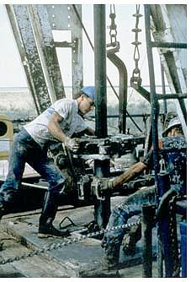
Natural Gas and Oil are Both Retrieved by Drilling
Both Natural Gas and Oil are often found along smaller faults deep within the Earth.
Coastal and northern Louisiana is abundant with natural gas reserves.
Louisiana is one of the top 5 natural gas-producing states in the US.
Photo courtesy of NASA

Slide 36

Natural Gas (cont’d)
Used in homes, businesses, industry, vehicles and power plants.
Consumption is expected to rise by 50% by 2025.
Since it is colorless and odorless, a scent is added to it for safety purposes – called a “mercaptan” – giving it a sulfur-based, rotten-egg type smell that cannot be removed.

Slide 37
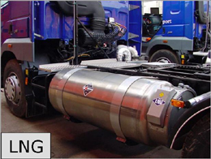
Natural Gas – different forms
Compressed Natural Gas (CNG) is an alternative fuel for gas and diesel engines, is stored in tanks similar to acetylene.
Liquefied Natural Gas (LNG) is used in large-scale industry. Cooled to -260F, it is now being used as a fuel for trucking and ocean-going vessels.
CNG and LNG Only accounts for 4% of natural gas consumption worldwide.

Slide 38
Hydrogen-Enriched Natural Gas
A blend of natural gas and hydrogen, usually 12% H and 80% NG.
Can reduce emissions of Nitrogen Oxides by 30-50% without affecting the performance of regular natural gas engines.
These 2 fuels come mainly from domestic supplies, lessening the US’s dependency on foreign countries.

Slide 39
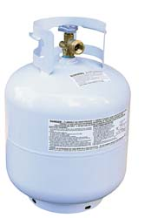
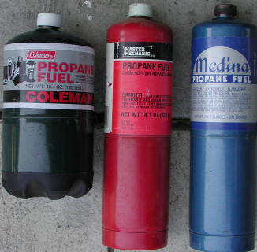
Natural Gas by-product … PROPANE
Fuel that is easily stored in pressurized tanks.
Used as fuel for cooking, transportation.
Also a by-product of oil refining.
Burns cleaner than gasoline or diesel.

Slide 40
Fossil Fuels Pose Problems
Coal, Oil and Natural Gas products are extremely widespread, and in higher demand each passing day.
Supplies will eventually be depleted.
Use of these products are filling landfills, polluting land, rivers, lakes, oceans, and air.
Oil spills are common, on average, 12 spills over 1000 gallons each occur every day.

Slide 41
In Louisiana, Drilling for Petroleum has Greatly Accelerated Wetland Loss
Canals dug for pipelines promote soil erosion.
Roads and levees erected for access to rigs hinders natural water flow, re-directing it into waterways causing additional soil loss.
Pollutants from drilling enters the environment, killing delicate wetland vegetation.
Increased use of larger drilling equipment necessitates deeper dredging of access canals, compounding the erosion problem.

Slide 42
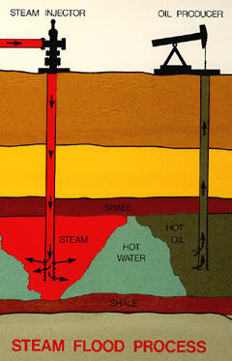
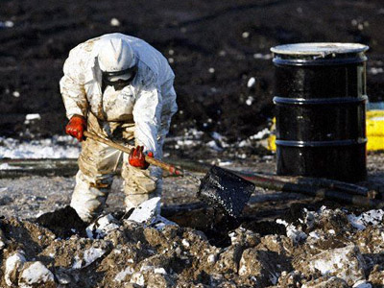
OIL SPILLS
DRILLING
Disrupts Earth’s natural strata
Threat of producing sinkholes
Possibility of water contamination
Destroy environment
Kills Wildlife
Expensive to clean-up

Slide 43
Oil Spills Pose Dangers
Environment is damaged, usually coastline wildlife losses are high.
Most of the oil is never recovered (usually only 10-20%) can be salvaged.
Oil sinks to seafloor, killing important decomposers, natural balance is interrupted.
Oil is eventually decomposed by marine organisms, however, it could enter the food chain of ocean wildlife, possible human contamination threat.

Slide 44
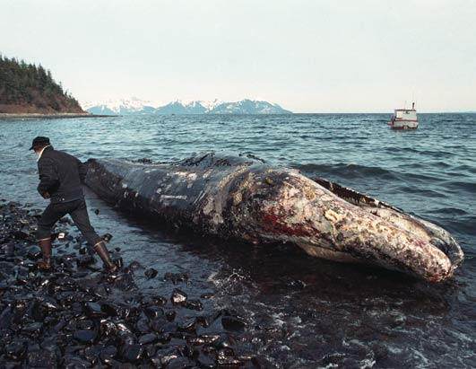
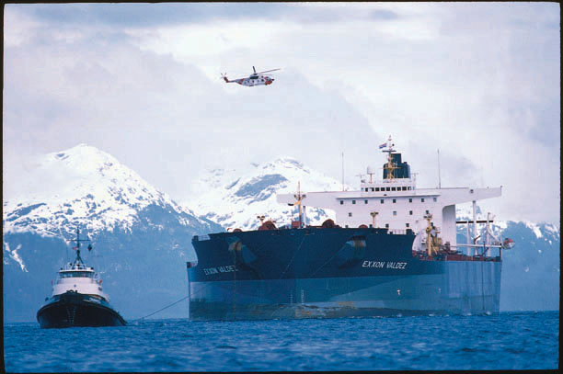
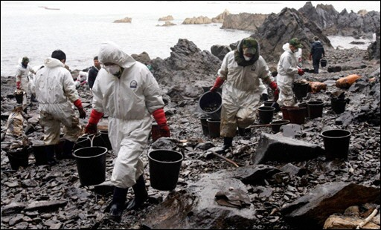
Most-Publicized US Oil Spill was the Exxon Valdez, March 24, 1989
Ran aground in Prince William Sound, Alaska, spilling more than 11 million gallons of crude.

Slide 45
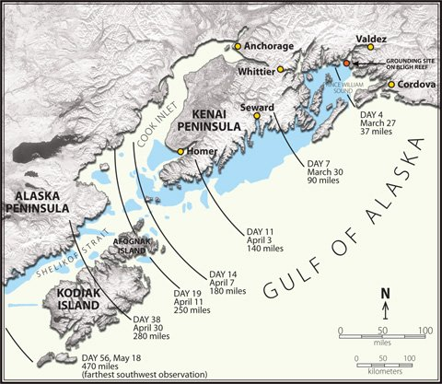
The Valdez spill affected over 1,200 miles of Alaskan coast.

Slide 46
Spills Don’t Just Occur in Oceans
Land spills can occur from the thousands of land-based rigs, pump-jacks, storage containers, refineries, and transport vehicles.
Spills on agricultural-producing land and irrigation sources usually result in costly clean-up and containment procedures.
Often spills can alter the land’s ability to produce, rendering the soil unusable for decades or longer.
To report an oil spill, contact the EPA at (800) 424-8802

Slide 47
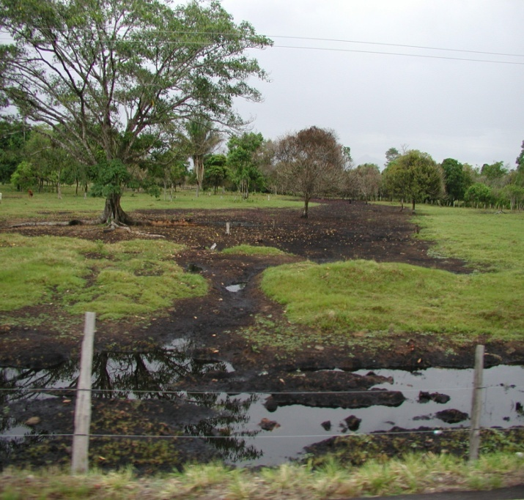
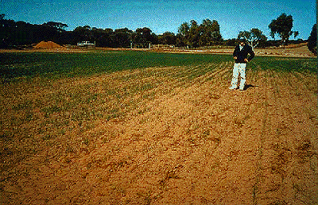
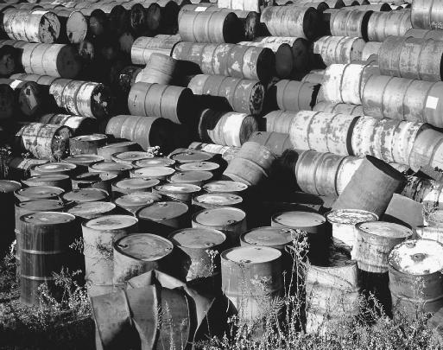
Land Spills Can Be Devastating and Permanent!
Leaking Oil Tank Damage
Wheat crop fails to grow where Oil Production rig once stood – 30 yrs ago
Sludge pits, storage tanks, fuel tank leaks, as well as numerous waste products from oil and gas production can devastate the soil’s ability to grow marketable crops in the US.

Slide 48
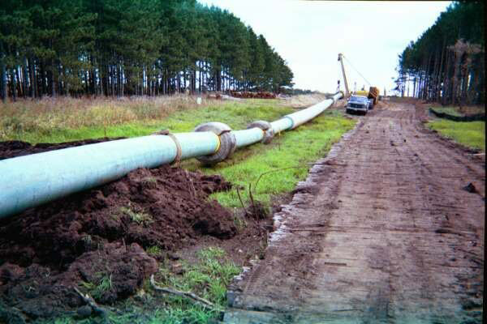
Pipeline Right-of-Ways
Areas where pipelines are buried cannot be used to grow crops.
Strips of land are usually of considerable length.
Blowouts can occur.
Photo courtesy of FERC

Slide 49
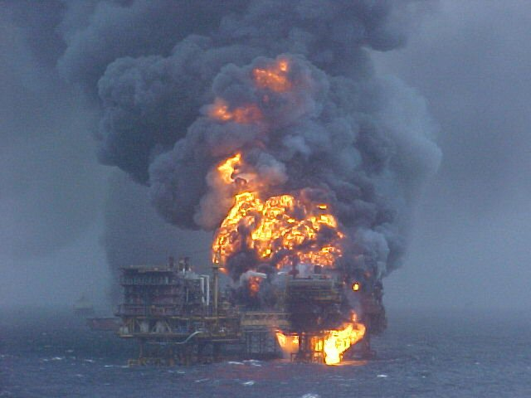
Drilling for Petroleum Demands Extreme Safety Measures
As more workers are needed for increased supplies, an increase in injuries can be expected if safety measures are not strictly enforced.
Courtesy of Canadian-Wellsite.com

Slide 50
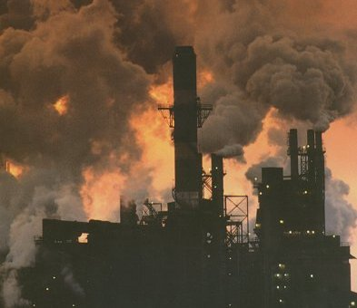
Burning Petroleum Products Produces Immense Amounts of Air Pollution
Smog
Human Illness
Crop failures
Acid Rain

Slide 51
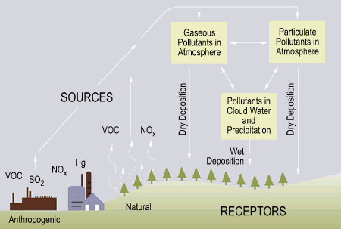
Acid Rain (an Agricultural Threat) Explained via Diagram:
Courtesy of MIT

Slide 52
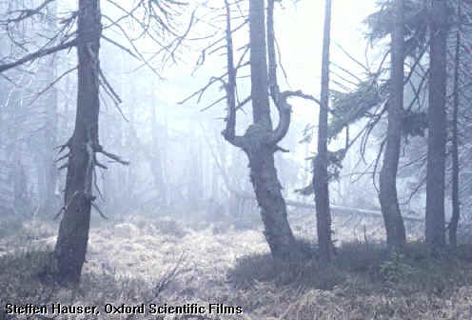
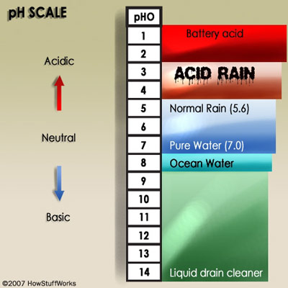
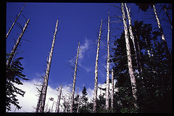
Acid Rain Damage is Already Occurring
To see a better depiction of the acid rain cycle, click HERE

Slide 53
What Threat Does Acid Rain Pose?
Calcium, a necessary element for soil filtration, is depleted by acid rain.
The loss of calcium can harm plant growth and result in plant die-offs.
Heavy metals (such as aluminum) can be absorbed by plants due to calcium depletion, resulting in diminished growth rates and plant die-offs.
Aluminum has been linked to Alzheimer’s disease in humans.
Research also links acid rain to climate changes.

Slide 54
Another Energy Source From Underground, but not from Fossils
As you recall, Fossil fuels are NON-renewable, and are found beneath the Earth’s crust.
Fossil fuels do not burn clean.
Uranium is also mined from beneath the Earth’s crust, and by controlling a reaction called “fission”, tremendous heat can be achieved.
Supplies are limited, but the energy it can create burns much cleaner than fossil fuels.

Slide 55
Non-Renewable Energy -
Short Review
Coal – several types, must be mined, acid rain, transportation expensive.
Oil – Hazardous retrieval and refining process, most is imported (costly), spills, acid rain.
Natural Gas – Same problems of production as oil, high transportation costs.
Nuclear (Uranium) – public acceptance a problem, dangerous waste, plants are expensive to build.

Slide 56
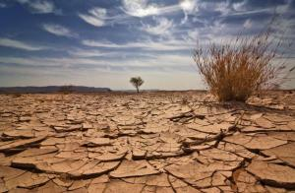
Fossil Fuels and Global Warming
Burning these fuels produce excessive amounts of greenhouse gases (CO₂) (source: US EPA).
Failing to reduce these emissions may likely cause our global climate to change … and if it changes, agriculture will definitely change.
The average temp has risen 1.6 deg F since 1880, and at a steep rate since 1960. To see NASA’s data on global temps, click HERE

Slide 57
Thermal Depolymerization
Process was invented in the mid 1990’s.
Uses heat (steam) and pressure to convert existing trash into short-chain hydrocarbons, used as fuels.
During the process, all disease-producing organisms are destroyed.
In 2003 a full-scale plant went into operation in Carthage, Missouri, more are being constructed.
Source: http://www.thermaldepolymerization.org/

